Slide 1


Embedding Energy Management
- Global trends presentation
Insert site / company name and logo here
Embedding Energy Management is available from www.sustainabilityskills.net.au
Manufacturing Skills Australia
1800 358 458
info@mskills.com.au
www.mskills.com.au
© 2013 Manufacturing Skills Australia. All rights reserved
Insert presenter/s names here
The material provided in this presentation has been produced in conjunction with our partner Energetics Pty Ltd.
This publication was funded by the Australian Government
through the Workforce Innovation Program under the title 'Carbonproof for Foundries'.
Notes:
1

Slide 2
Context – resource use and cost at this site (from Energy baseline tool)

Slide 3
Site business plans and existing energy related targets/goals
Business plans
Expansion / acquisitions
Product changes
Plant and equipment upgrades
Suppliers and customers
Compliance changes
Profit and / or efficiency targets
LEAN targets
Energy targets/ goals
Sustainability/environment targets

Slide 4
Sites energy use insert here
Notes:
Refer MSA energy baseline tool to source graphs

Slide 5
Global trends for the Foundries, Fabricators and Related Industries

Slide 6
Ecosytem interactions
© Energetics Pty Ltd , Holt et al

Slide 7
Major trends in Foundries Sector
Dr.-Ing. Gotthard Wolf, German Foundry Association Farouk Varachia, Metal Casting Technology Station, SA
Market
  Production dominated by China
  Increasing influence on consumption by BRIC
  Regional casting markets but global companies - Consolidation?
  European and American market remains but economic growth in Asia
  Following the OEMs, companies build their new automotive foundries in the emerging markets.
Technical
  Enlargement of added value chain
  Complex lightweight castings
  Energy efficiency, integrated environmental protection
  Avoidance of non value-add steps – e.g.stress relief heat treatment
  Automation

Slide 8
Major trends in Foundries Sector
Import Competition
  Decreasing commodity prices
  Import / export regulations
  Carbon protectionism
Sustainability Compliance & Labelling
  ISO 50001 Energy Management System
  Carbon Disclosure Project/ Global Reporting Initiative
  Other Customer requirements

Slide 9
Drivers for action by business
Cost
  Rising for energy, water, carbon
Competitiveness
  Tighter margins, ‘green’ differentiation
Compliance
  Increasing regulatory burden as Governments seek to overcome markets failure to act
Community expectation
  brand reputation
Customer
  Supply chain pressures, footprints and green credentials

Slide 10
Redefining Business Success
Not just financial measures
Engagement of a broader range of stakeholders
Mutual understanding of needs
Understanding how your business will fit into a new business paradigm
Social
Environmental
Economic

Slide 11
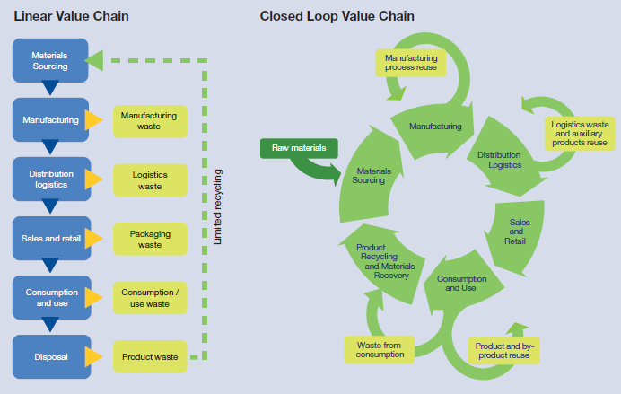
e.g. Redefining the value chain

Slide 12
Organisational evolution - where do want to be?
Innovator
Industry development is driven by relative impacts of:
Government Policy
  Industry Innovation
  Social Conscience
Proactive
Long-Term
Reactive
Timeframe of thinking
Organisations will develop at different speeds and early movers will create sustainable competitive advantage
Compliant
Denial
Immediate
Low
High
Sophistication of thinking about sustainability impacts
© Energetics Pty Ltd

Slide 13
Australian trends, policy and legislation

Slide 14
Australian Energy Trends
The cost of energy in Australia has been at a significant discount with respect to the rest of the world for the past decades. This is changing for a range of reasons including:
  Water shortages has limited capacity of some large hydro electricity generation stations
    Tarong & Swanbank in QLD limited to 50% in 2007-2008
  LNG exports will cause natural gas prices to rise to world market levels
  Underinvestment in and growth in demand on electricity networks
    Significant increases in price of grid electricity out to 2020
    Possibilities for distributed generation?
  Increasing scarcity and rising cost of petroleum
  Increased renewable energy targets (MRET)
    Land use and waste business decisions
    Competition by biofuel for arable land
  Customer and Consumer demands for green credentials including organics and carbon emissions

Slide 15
Electricity price escalation
- doubling by 2020
C Price
Electricity cost increase drivers
Increasing network costs
Renewable energy target
Energy efficiency schemes
Carbon costs
Increasing energy commodity prices
$45B infrastructure investment in 5 years for electricity supply = much higher network prices.

Slide 16
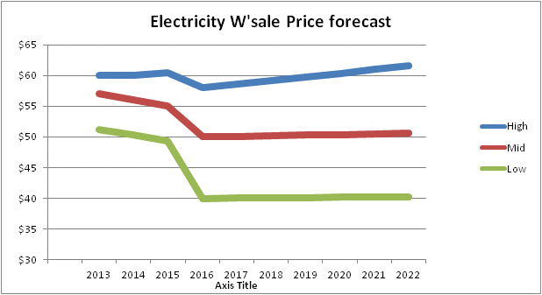
Electricity Price Outlook
Electricity price have recently increased for carbon costs
Electricity demand is declining and is likely to be static in future
Coal input costs have abated somewhat from recent highs
Gas will play a much smaller role than we previously thought
Ample generation has traditionally led to a fight for market share
There are very few influences on the horizon that would lead to price increases
Carbon cost changes will be the key price influence in the short term
Reproduced with kind permission
from Energetics Pty Ltd

Slide 17
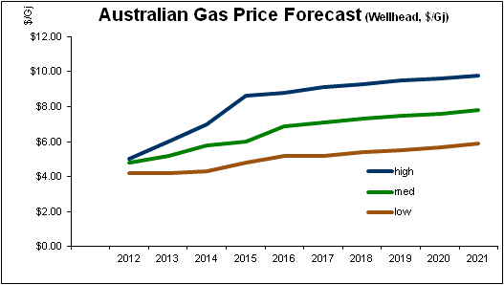
Australian Gas Price Outlook
Wholesale Gas (Wellhead)
Gas prices have doubled
2015 gas now sells for $8-$9/GJ (inc carbon)
LNG has bought global prices to Australian gas
Future prices will be set by Asian LNG prices, not local issues
This already happens in WA
Local demand is static to declining
Gas volume quadruples with the introduction of LNG but the price doubles
New Gas generation isn’t needed for the near future
Recent gas tender prices (July 12)
2014 : $6.50-$7.00 / GJ (inc carbon)
2014 : $8.30-$8.60 / GJ (inc carbon)
2016 onwards not available
Reproduced with kind permission
from Energetics Pty Ltd © 2013

Slide 18
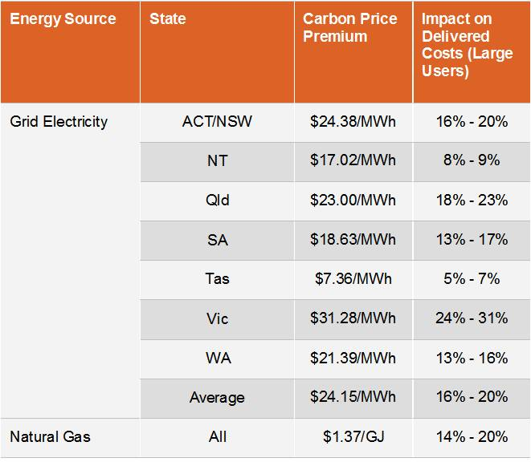
Energy price increase from
Carbon price at $23 per tonne CO₂-e
Source : Energetics Pty Ltd 2012

Slide 19
The game has changed! How 8 year payback project in 2008 is 3.5 years in 2012
Note also reduction in capital cost from strong $A (not included)
Source: Energetics Pty Ltd 2012

Slide 20
Impact of electricity costs, exchange rate, carbon price (and capital grant)

Slide 21
Energy programs / initiatives
Improving
Energy Efficiency
Reducing
Greenhouse Gas &
Carbon Emissions
Increasing
Renewable Energy
EEO
Energy Efficiency Opportunity Act
Voluntary Greenhouse reduction programs
Voluntary
GreenPower
NGER
National Greenhouse & Energy Reporting Act
RET (LRET and SRES)
Renewable energy targets
State Energy Efficiency programs e.g. VEET, ESS, EREP, Sustainability Advantage, SESP
Carbon Pricing
(Future ETS post-2015)
State renewable energy targets
© Energetics Pty Ltd

Slide 22
Efficiency to underpin carbon abatement to 2020
Significant drops in emissions are required to meet Australia’s Kyoto commitments as outlined by the figure below. How will this be achieved? Energy efficiency is forecast by the International Energy Agency to be the major source of carbon reductions out to 2020 in industrialised countries.

Slide 23
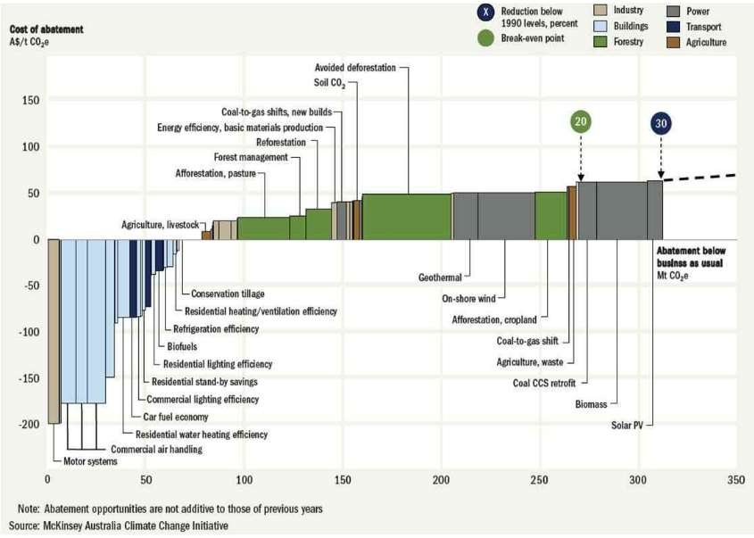
McKinsey’s MAC analysis agrees
McKinsey’s analysis shows energy efficiency to be among the most cost effective carbon abatement measures. Sitting to the left, below the line are the ‘just do it’ projects

Slide 24
Energy planning model

Slide 25
Planning a strategic response to energy related business trends in the Foundry and Fabrication industries
Strategic Guidelines
Policies
Plans
Programs
Contextualizing:
Internal impacts
Existing business plans and initiatives
Risks and opportunities
Business goals
Development of strategic questions
External trends (environmental scanning)
Current status
Potential status
Program development

Slide 26
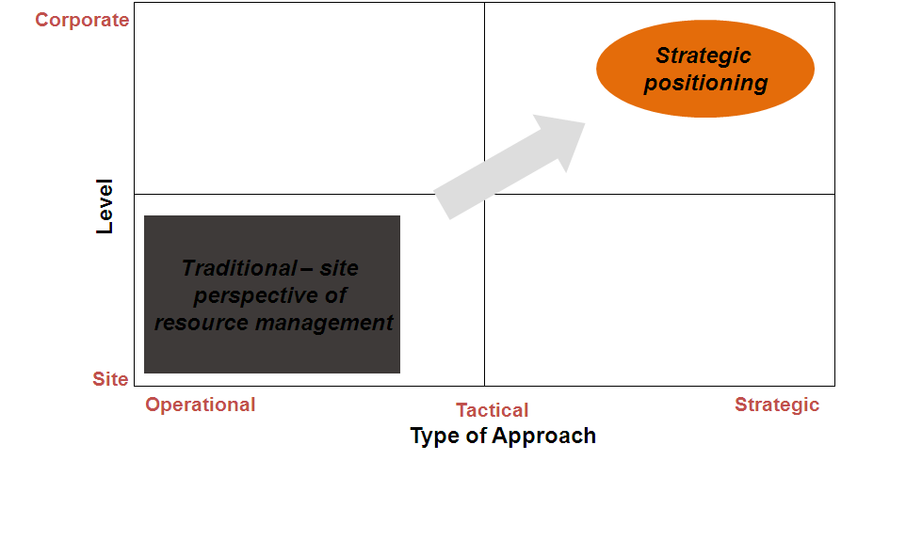
Where do you want to be?
What is important to you?
Where do you want to be?
How does the global situation impact you?
Are you prepared?

Slide 27
Identify business initiatives & plans
Identify your current initiatives that your business is doing / planning that align with economic, social and environmental performance goals
  List business initiatives
  Map onto Venn diagram
  Where do they fit? - provides basis for understanding business approach, defining your current approach, and starting to highlight ‘gaps’ in your systems that you may want to close

Slide 28
For example
Social
Employee Development Programs
Outplacement support, Job search assistance
Community clean up campaigns
Parental leave policies
Green skills development
Master plan process
Lower emissions to air
Water efficiency target
Production volume increase
Automation of pH sampling of wastewater stream
Recycle
materials
EBIT target
Environmental
Economic

Slide 29
Social
Environmental
Economic

Slide 30
Given these plans, where are you placed on energy / carbon?
Innovator
Industry development is driven by relative impacts of:
Government Policy
  Industry Innovation
  Social Conscience
Proactive
Long-Term
Reactive
Timeframe of thinking
Organisations will develop at different speeds and early movers will create sustainable competitive advantage
Compliant
Denial
Immediate
Low
High
Sophistication of thinking about energy carbon and sustainability
Reproduced with kind permission
from Energetics Pty Ltd
© Energetics Pty Ltd

Slide 31
Where do you want to be positioned in the future?
Innovator
Industry development is driven by relative impacts of:
Government Policy
  Industry Innovation
  Social Conscience
Proactive
Long-Term
Reactive
Timeframe of thinking
Organisations will develop at different speeds and early movers will create sustainable competitive advantage
Compliant
Denial
Immediate
Low
High
Sophistication of thinking about energy carbon and sustainability
Reproduced with kind permission
from Energetics Pty Ltd
© Energetics Pty Ltd

Slide 32
Consolidating the trends and your plans and position….
The previous activities define the endpoints for:
  Business maturity
    This defines where you want to be against your competitors
  Positioning
    This defines how you want to achieve your goals
  Combining your review of trends, assessment of your plans, position and desired future positioning, you are now in a position to assess your risks and opportunities for getting there, and to develop your vision and guiding principles for your strategy development

