Slide 1


Embedding Energy Management
– Carbon introduction
Insert site / company name and logo here
Embedding Energy Management is available from www.sustainabilityskills.net.au
Manufacturing Skills Australia
1800 358 458
info@mskills.com.au
www.mskills.com.au
© 2013 Manufacturing Skills Australia. All rights reserved
Insert presenter/s names here
The material provided in this presentation has been produced in conjunction with our partner Energetics Pty Ltd.
This publication was funded by the Australian Government
through the Workforce Innovation Program under the title 'Carbonproof for Foundries'.
Notes:
1

Slide 2
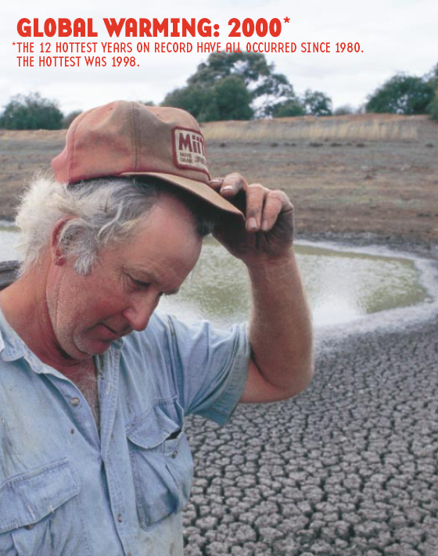
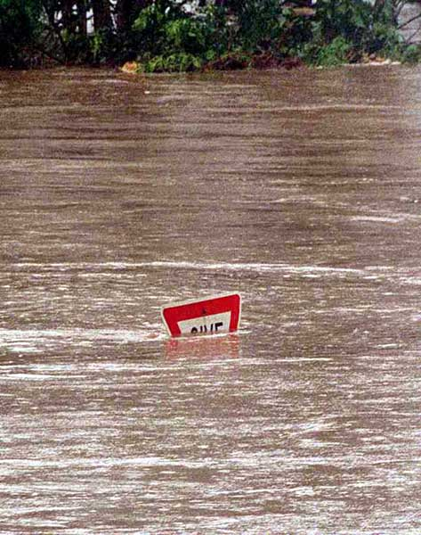
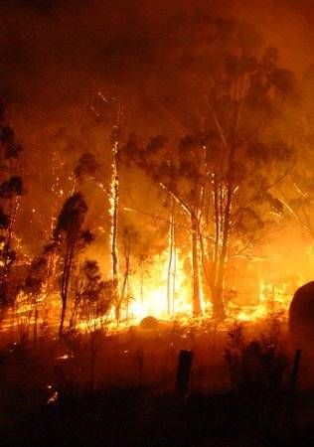
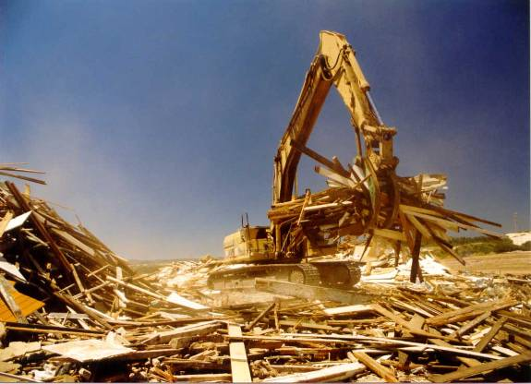
What is the problem?
Climate change
Resource depletion
  Energy
  Water
  Materials
Increased emissions, contamination & waste
Reduced air quality
Loss of biodiversity

Slide 3
How is economic activity affected by climate change?
Agriculture, tourism and insurance
Directly affected
- more droughts, floods and bush fires.
Carbon taxes, energy tariffs emissions trading.
To address climate change, emissions must be reduced
Impact upon other sectors
Energy sector costs flow through to energy intensive sectors – mining, manufacturing
Indirect impacts include
Reduced demand for products
Disruption to business activities
Potential litigation
Brand and reputation risk
Longer term global impacts potentially:
Social unrest.
Political instability
Large scale refugee movement

Slide 4
Risks specific to Australia
Energy pricing
Low energy costs, greenhouse intensive coal sources
Costs to increase – oil prices, carbon, lack of investment, drought conditions
Access to Water
Australia is the driest continent on earth
Many industry sectors are dependent on access to water for operation.
Regulatory uncertainty
Carbon Price, leading to Emissions Trading.
Uncertainty - difficulty in long-term infrastructure/ asset planning
Market related risks
Climate change risks in other countries may differ remarkably – regulations, consumer behaviour

Slide 5
Things to consider when managing carbon – organisational boundaries
Decisions must be made as to how emissions will be aggregated. Three approaches include:
Equity share
Financial control
Operational control
Operational control is default boundary!
– required for reporting to Australia’s National Energy and Greenhouse Reporting System (NGER)
What is operational control? Defined in Australian law as the right to introduce or implement operating, health and safety or environmental policies

Slide 6
Things to consider when managing carbon – operational boundaries
Scope 1
“Fuel You Burn”
Scope 2
“Fuel burnt for You”
Scope 3
“Emissions from services you use and products you produce”
LPG
Nat Gas
Petrol
Process emissions
Electricity

Slide 7
Reporting / reduction programs
NGER (Australian) – Mandatory reporting of national energy consumption and production and greenhouse gas emissions above legislated thresholds.
Carbon Price (Australia) 1 July 2012 - $23/tonne CO₂-e. Emissions trading scheme (variable price) from 2015.
EEO (Australian) – Mandatory identification of energy efficiency opportunities by energy users above legislated thresholds.
CDP (International) – Voluntary requests for greenhouse and energy disclosure from over 2,500 organisations. CDP acts on behalf of 655 global institutional investors.
NB: No longer considered “voluntary” for Australia’s top 200 companies

Slide 8
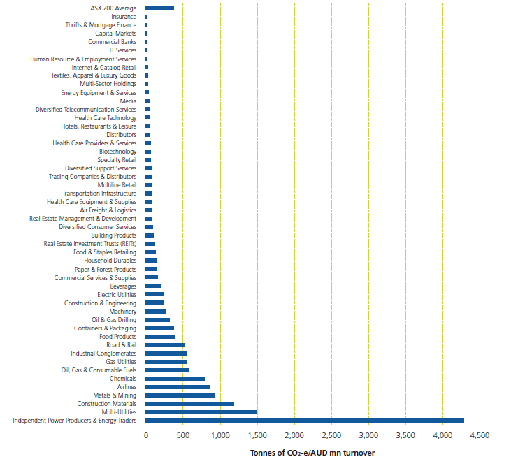
The business case for carbon management– emissions & profit
Figure 8: Carbon intensity by sector (VicSuper Carbon Count 2009)

Slide 9


The business case for carbon management – carbon management by suppliers
Ford looking to reduce carbon footprint in supply chain:
2011 survey of 128 global suppliers
Represent $65bn of annual purchases
Goal to understand better the supply chain carbon footprint
Translate to risks and opportunities
Survey suppliers annually
e.g. Toyota global requirements – improving environmental performance. Suppliers to improve in:
CO2 emissions
Water consumption
http://www.toyota.com.au/toyota/sustainability/community-and-stakeholders/suppliers
http://reviews.cnet.com/8301-13746_7-20118783-48/ford-looks-to-reduce-carbon-footprint-in-supply-chain/

Slide 10
The business case for carbon management – Carbon Price
Some will pay directly
eg. Large users of coal such as coal fired power stations
Q: Who pays the Carbon Price?
Some will pay indirectly
eg. Consumers of electricity / smaller users of fuels
Think petrol excise – you pay, but payment collected upstream
Buyers of goods, esp energy-intensive products or materials

Slide 11
Risk and opportunity identification
These include:
Physical – damage to functioning of assets / take advantage of shifting climatic zones
Regulatory – exposure to / seize opportunities around:
- current and future requirements;
- administrative burden;
    - direct and pass-through carbon price costs (carbon price and trading)
Litigation – CEO liability or opportunity (NGER and EEO)
Competitive – business environment will change – advantage or risk?
Reputational – information is in public domain

Slide 12
The business case for carbon management
Experience shows that sustainability makes good business sense
Embedding sustainability within an organisation’s broader business strategies frequently results in organisational and technical innovations that generate both top- and bottom-line returns.
Reducing inputs to a business, due to a carbon-constrained economy, reduces costs.
Reducing inputs requires new or improved products or even new business lines.

Slide 13
Additional slides for management presentation
Insert following slides as required using data from “What's my footprint “ tool

Slide 14
Summary graph from baseline tool
Insert summary graph from baseline tool - Example

Slide 15
The size of your footprint
Insert summary graph 1 from inventory - Example

Slide 16
Scope 1 v Scope 2 emissions
Insert Summary graph 2 from inventory - Example

Slide 17
Energy use by emissions source
Insert summary graph 3 from inventory - Example

Slide 18
Carbon price impact
Insert summary Slide 4 from inventory - Example

