Slide 1


Embedding Energy Management
- Energy procurement presentation
Insert site / company name and logo here
Embedding Energy Management is available from www.sustainabilityskills.net.au
Manufacturing Skills Australia
1800 358 458
info@mskills.com.au
www.mskills.com.au
© 2013 Manufacturing Skills Australia. All rights reserved
Insert presenter/s names here
The material provided in this presentation has been produced in conjunction with our partner Energetics Pty Ltd.
This publication was funded by the Australian Government
through the Workforce Innovation Program under the title 'Carbonproof for Foundries'.
Notes:
1

Slide 2
Overview of Energy Markets Deregulation

Slide 3

System components
Generator
Transmission lines
Distribution lines
Retailer
AEMO
(regulator)
Financial flows
Physical flow of power
End users
Reproduced with kind permission
from Energetics Pty Ltd
© 2013

Slide 4
Electricity Supply Chain
MAKES THE PRODUCT - ELECTRICITY
Costs included in Energy Charges
GENERATION
TRANSMISSION
DELIVERS THE PRODUCT TO THE SYSTEM
Regulated & Passed on to Retailer via Network Charges
DELIVERS THE PRODUCT TO THE CUSTOMER
Owns the Poles and Wires. Regulated Network Charges.
DISTRIBUTION
SELLS THE PRODUCT TO THE CUSTOMER
Manages Risk & Bundles Charges.
RETAILER
CUSTOMER
THE END USER
Uses the electricity & pays the retailer
Reproduced with kind permission
from Energetics Pty Ltd
© 2013

Slide 5
Deregulation process – electricity
Commenced from 1994, with the largest sites first
  Purpose was to promote competition in retail and generation sectors, allow users to choose a retailer, and increase efficiency
Single Generation, Network and Retail companies were separated into separate entities
  Generators and retailers set their prices via the market, network providers’ prices continued to be regulated
For customers, deregulation means:
  The right to choose who supplies your electricity invoices
  No change to network provider
  Small sites typically retain bundled billing
  Large sites on contract move to unbundled billing

Slide 6
National Electricity Market (NEM)
National Electricity Market established in 1998 to facilitate deregulation.
Electricity can physically flow between states.
Each state has separate markets where generators can sell their output and retailers can buy their demand.
  Prices set by supply and demand
WA electricity market and billing differs significantly to the NEM
Source: AEMO SOO 2009

Slide 7
Deregulation status – electricity
State
Started
Current Status
Deregulation
ACT
1997
Fully Deregulated
NSW
1996
Fully Deregulated
QLD
1998
Fully Deregulated
SA
1998
Fully Deregulated
VIC
1994
Fully Deregulated
NT
2000
Deregulated to
750MWh
TAS
2006
Deregulated to
150MWh
WA
1997
Deregulated to
50MWh
Example: www.eriu.energy.wa.gov.au/3/3122/3073/contestability_.pm

Slide 8
Deregulation status – natural gas
For natural gas customers:
  All states except NT have contestable natural gas supply
  Tasmania and NT have very limited gas networks
  No change to network provider if you move retailers
  Small sites typically retain bundled billing
  Large sites on contract move to unbundled billing
For all energy supplies, you can always discuss with your supplier whether your account is ‘contestable’

Slide 9
Electricity spot and futures markets
Electricity bought and sold in the NEM is via a central pool
The Australian Energy Market Operator (AEMO) selects the lowest cost combination of generator offers to meet demand
The highest priced accepted offer sets the half hourly Spot Price, with this price received by all dispatched generators
Shortage in supply v demand forces spot prices up, and vice versa
Spot prices range -$1,000 to $12,500/MWh with a typical price for around $40/MWh.
To mitigate the risk of fluctuating spot market prices a secondary ‘futures’ market has developed, which predicts spot prices for a given period in the future
Generators and Retailers can use the Futures Market to agree a fixed price to trade electricity, which increases certainty

Slide 10
Key Points so far
Deregulation provides a choice of supplier, but not of network provider
National Energy Market is a wholesale electricity market and interconnected supply network for ACT, NSW, Qld, SA, Tas & Vic
Spot prices are set to clear supply and demand every 30mins
Futures prices are projections of what the average spot price will be in a later period

Slide 11
Two ways to ensure you are paying the best price
Tariff analysis - need to understand how your bill is made up and your tariff options e.g. Do you pay for KVA? Peak load? Time of use?
Contract negotiation – need to understand contract conditions and how to de-risk the contract for the retailer so that you can negotiate the best possible price

Slide 12
Tariff analysis
Formats and Components of Electricity Billing

Slide 13
Delivered electricity costs

Slide 14
Typical bundled invoice small sites
Individual Cost Elements Not Identified On Bill

Slide 15
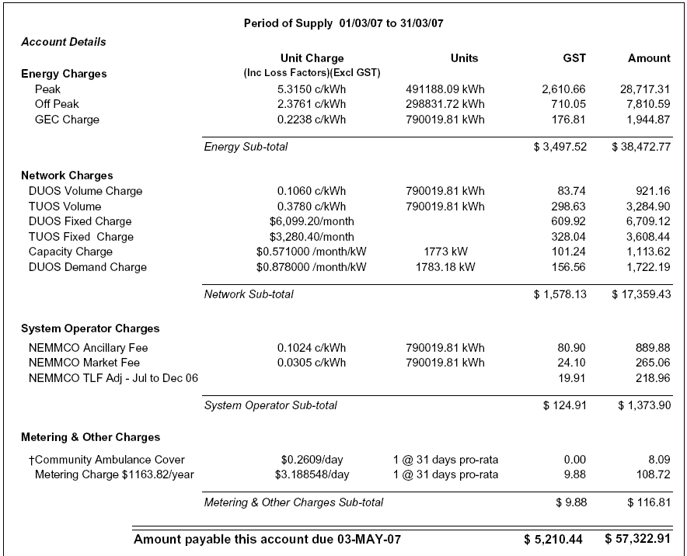

Typical unbundled invoice large sites
Generator
Contestable. Prices vary by supplier.
Non-Contestable. Prices vary by location.
Transmission lines
Distribution lines
Non-Contestable. Prices vary by state.
Market Manager
AEMO
Contestable. Prices vary by supplier.
Meter Agent

Slide 16
Bundled v Unbundled
Typical sites on bundled billing:
  Sites that have remained on franchise tariffs.
  Domestic supplies
  Small contract electricity supplies (<$25k annual spend)
Typical sites on unbundled billing
  Large contract electricity supplies

Slide 17
Charge components
Energy – generator, retail margin
Network – transmission + distribution
Market – NEM fees
Metering – fee for each metering point
Environmental – renewable energy, retailer obligation scheme pass-through fees

Slide 18
Energy Charges
Account for the physical commodity used by the customer
Largest negotiable cost element
Quoted and charged in $/MWh or c/kWh
  For large sites, prices usually split into Peak and Off Peak periods (plus a shoulder period in ACT and NSW).
Contract rates will be escalated by losses when invoiced
Determined by the underlying futures market prices when contracting

Slide 19
Losses
Energy lost between generation and the point of use
Expressed as a percent (e.g. 4.8%) or a factor (e.g. 1.048)
Only apply on unbundled pricing arrangements
Will cause your billed rates to differ from your contract rates
Energy rates escalated by DLF and TLF multiplied together
Environmental and market charges escalated by DLF only
Network and metering charges are not impacted by losses
Updated annually from 1 July by the Australian Energy Market Operator and published on their website
  So, from 1 July your billed rates may change, even if your contract rates haven’t!

Slide 20
Environmental Charges
Federal and State Government schemes
Allow retailers to pass on the costs of meeting legislated environmental schemes to the end user
Are a negotiable element of your contract/billing
  Differences between retailers’ enviro prices can be greater than the differences between their energy prices
  Important to analyse combined energy and enviro rates when comparing retailer offers
Are escalated on bills by the Distribution Loss Factor
Depending on the State, enviro charges will form around 4-10% of total bill costs
If you don’t request firm enviro prices, your retailer will usually amend prices during the contract to follow market movements

Slide 21
Network Charges
Covers the ‘poles and wires’ costs
Passed through at cost by your electricity supplier
Charge structures are designed to incentivize customers to use electricity in a way that relieves stress on the supply network – e.g. peak/offpeak rates, kVA demand charges
Prices fully regulated and set annually (usually)
Most network providers give the customer several choices of network tariff. The lowest cost option can be selected
Typically form 30-50% of bill costs depending on site location and type of usage
  This proportion is increasing due to significant investment requirements across the networks
  For example, NSW network prices increased by around 20% from 1 July 2010

Slide 22
Market Charges
Costs applied by the Australian Energy Market Operator for running the market
Retailers can recover AEMO’s costs from the customer by passing through charges on invoices
Two charges which change each 1 July:
  AEMO Ancillary Services Fee
  AEMO Market Participation Fee
Both charges will usually amount to <1% of total bill cost, and are non-negotiable, so significant management is not merited

Slide 23
Metering Charges
Covers the costs of installing and maintaining a site’s electricity meter, as well as recording and processing usage data
Is a negotiable charge element:
  Customers can contract directly with a metering provider and ask retailer to pass through costs; or
  If the Customer does not nominate a metering provider, the retailer will appoint one on the customers behalf.
Typically, a saving of $100-200/per meter per annum (10%-20%) can be made under option 1
Advantages of Contracting Directly with a Metering Provider:
  Typically lower metering charges
  Direct access to online metering data
  Usage alarms (high demand etc)
  Linking other utilities for reporting (water, gas)
  Loss of supply notification

Slide 24
GreenPower
Some customers choose to make a voluntary purchase of electricity generated from renewable sources
“GreenPower” is the Federal Government’s renewable energy program
Purchasing GreenPower is purely a ‘bolt-on’ purchase
  There is no alteration to your physical supply of electricity
  GreenPower and electricity purchases can be ‘decoupled’ and bought through different providers

Slide 25
Key Points
The Futures Market is the main driver of energy contract rates
Network charges are regulated, but savings can often be made by switching tariffs
Losses apply to energy, environmental and market charges
Environmental charges are separately negotiable
Metering services can be contracted separately and passed through

Slide 26
Contract Negotiation - Key Principles

Slide 27
Types of Contract
Decreasing budget certainty, but potentially higher reward
1. Fixed price fixed volume forward contracting
2. Flexible forward purchase of variable volume
3. Fixed block purchase (e.g. with generator) with partial pool exposure
4. Portfolio purchase of fixed volume (partial pool exposure)
5. Managed pool exposure with active demand management or financial cover
6. Pool price pass-through
Over 95% of contract customers use Option 1

Slide 28
What does a contract cover?
Energy price and quantity
Contribution to mandatory environmental obligations (RECs, NGACs, GECs etc)
Metering (optional)
Account management
Billing
Not:
Delivery of energy
Security of supply
Regulated charges
Losses

Slide 29
Option 1–Fixed Price Fixed Volume
MW
Demand
Retailer carries volume risk (within +/- 10% of nominated
annual volume) as well as risk of demand fluctuations.
Actual Demand
2011
360 GWh annual volume +/- 36 GWh.
370 GWh annual volume +/- 37 GWh.
2012
Fully positioned for 2011 & 2012 electricity requirements
Need to buy for 2013 onwards
2011
2012
2013
2014
2015

Slide 30
Option 1–Fixed Price Fixed Volume
Customer agrees to buy from retailer for fixed price for a set term
  “Standard” form of electricity contract
Advantages | Disadvantages
All market risk is on retailer – no exposure to rising market prices. | No benefits will be received if market prices fall during the contract.
Standard form of contract with low ongoing maintenance. | Little flexibility should your requirements change mid-contract.
Price certainty – retail elements of an invoice will not change from the agreed rates.

Slide 31
Contract Options
Majority of customers seek a fixed price-fixed volume contract
Key Features:
  Customer nominates annual energy usage for each contract year
  Retailer provides fixed energy rates (and enviro rates if requested) for each contract year
  Customer is permitted to use, typically, between 90% and 110% of the nominated annual volume at the agreed rates
    Usage outside these bounds may incur penalties
  No limits on demand
  Network and market charges are passed through on billing

Slide 32
Issues to consider when contracting
Timing
  Vital in a volatile market
Approvals process
Duration of contract sought
  Short term (e.g. 12 month) contracts for new supplies to allow load profiles to be built
Volume & site roll-in/roll-out
Environmental charges (RECs, White Certificate Schemes)
Option of franchise prices for new supplies in Queensland
Additional account services – are services such as electronic billing and data provision required?
Voluntary GreenPower

Slide 33
Procurement Process–Timing & Approvals
Prices can vary significantly on a daily basis
  Prepare to go to market at short-notice and take advantage of price dips
  Important to streamline the procurement process in a volatile market
  Reduce the offer validity period as much as possible in order to lower the retailer’s risk premium and maximise the likelihood that the offer is still available when accepting prices.
A $1/MWh market movement equates to a cost change of $50,000 per annum for a 50 GWh supply

Slide 34
Minimising the increase
There are a few steps that clients can take to minimise the impact of increasing electricity costs when seeking a fixed-price fixed-term contract:
  Maximise retailer participation
    Keep things simple
  Provide detailed and accurate data, including information about future changes where known
  Don’t include unreasonable requests
  Keep to the project timetable
  Prepare for internal sign-off
  Make a quick decision

Slide 35
Minimising the increase – making a quick decision
Historically, retailer offers have been valid for acceptance for two weeks.
  This is no longer possible in a volatile market.
  Reducing validity period reduces risk premium that retailers will add into pricing
Who needs to sign off on the contract?
  How available are they?
  How can we help prepare them so that when the time comes they are happy to approve the deal?
  What information will they need?

Slide 36
Post-contract review
A lot of time goes into agreeing an electricity contract
Vital to undertake post contract reviews into:
  Bill checking
    Do billed rates match contract rates?
    Are network costs passed through correctly?
  Load variance
    Are sites within the permitted usage variance?
  Is the supplier delivering everything they committed to?
    Reports, notifications etc.

Slide 37
Key Points
Fixed-price fixed-term contracts are the ‘vanilla’ form of agreement
Timing of going to market is vital
Be ready to act quickly to take advantage of market price drops
Streamline tendering processes

Slide 38
Opportunities for Savings

Slide 39
Steps to assessing savings
Identify your site-type
Assess opportunities for:
Switching franchise tariffs (if applicable)
Moving to contract
  Evaluate risks and opportunities in contracting separately for energy, enviro and metering
Switching network tariffs
Power factor correction, if your site is on a kVA-demand tariff
Validate invoices

Slide 40
Minimising energy charges
Agree contract rates when the market price is low
  Easier said than done!
  Monitor market prices and don’t rely on the market being attractive 1 month before your existing agreement expires
Provide historic meter data and forecast load changes to suppliers when requesting prices
  Reduces risk premium in pricing
Do not include unnecessary requests in your tender/contract, as you will usually pay for them
Demand Side Management network providers and retailers are often prepared to pay you if you are able to curtail demand at short notice

Slide 41
Minimising network charges
Select the lowest cost available published tariff
  Tariffs published on network providers’ websites
  Tariff change applications can be made via your retailer
Monitor power factor on sites with a kVA-demand
Where possible, look to shift load into off peak (or shoulder) periods and minimise maximum demands

Slide 42
Site-specific data
Insert details of current energy contracts, highlighting peak/offpeak rates, negotiated components, overrun or excess charges incurred, expiry dates

Slide 43
Site-specific invoice data
Insert copies of site energy bills, highlighting relevant components

Slide 44
Site-specific Interval data
Insert interval data charts obtained from your retailer and/or from your baseline analysis

