Slide 1


Embedding Energy Management
- Energy management systems presentation
‘Energy efficiency assessment processes and practices– maximising engagement and take up of cost savings opportunities’
Insert site / company name and logo here
Embedding Energy Management is available from www.sustainabilityskills.net.au
Manufacturing Skills Australia
1800 358 458
info@mskills.com.au
www.mskills.com.au
© 2013 Manufacturing Skills Australia. All rights reserved
Insert presenter/s names here
The material provided in this presentation has been produced in conjunction with our partner Energetics Pty Ltd.
This publication was funded by the Australian Government
through the Workforce Innovation Program under the title 'Carbonproof for Foundries'.
Notes:
1

Slide 2
Purpose of this guide
To show how the energy efficiency improvement process operates within [insert company name] so that you know when and how to maximise input from others in the business leading to higher levels of implementation
To provide a template for generating ideas within your business so that you have an effective and efficient way of getting the ball rolling on resource efficiency and GHG reduction
This module is for those learning to facilitate an idea brainstorming session however some slides can be used live to guide the group through the process

Slide 3
A process for assessing energy efficiency opportunities
Baseline tool
Efficiency opportunities workbook
Present energy baseline, walk thru site, gather a team, create list of energy efficiency opportunities
Quantify the list of energy saving opportunities
Gather management team to categorise and prioritise the list of opportunities
Action plan the implementation or investigation and monitor progress
Verify and report savings at regular management & budget meetings
Workshop option
Workshop option
– processes to assess and progress opportunities– tools to quantify, assess and report opportunities and gain input from others in a collaborative way
Efficiency opportunities workbook

Slide 4
Energy baseline
Insert energy baseline graph(s) here using the EEM baseline tool, to inform identification of opportunities

Slide 5
How we turn ideas into action
Improved energy and water efficiency and
reduced Greenhouse emissions
Ideas
Opportunities
Projects
Action
Ideas that
might improve
our performance
Opportunities that
should improve
our performance
Projects that
will improve
our performance
Generated by …
us!
Evaluated by …
us for those we can do
or by TBC for those we can’t
Analyzed, justified and resourced by …
Today,
we are here

Slide 6
A process for generating ideas
Idea Creation (Brainstorm)
Concretize
and Decide (Projects)
Next
Steps
Diverge
Converge
Start
Group into Themes
Stage1
Stage 2
Stage 3

Slide 7
Session structure
Intro & warm up (5-10 mins)
  Meet and greet all participating as they arrive
  State purpose and process- could use slide 3&4 to help you do this
  Use 1 or 2 examples of past efficiency projects to illustrate the potential benefits, or ask a warm-up question – e.g. how and where do we use energy on this site?
Body of the session (30-60 mins)
  Get ideas using focusing question, then sort after they finish generating ideas
  (Optional) screening of ideas using project ranking method
  Get them to concretize ideas in pairs using a purpose statement for each group of ideas
  List down what they will do (activities) next to progress these ideas
Conclusion (2-5 mins)
  Give the group positive encouragement about getting the ball rolling on resource efficiency / carbon reduction - seek comments on improving these sessions
  Tell them what happens next (ensure a commitment and timeline to feed back)

Slide 8

Step 1 – create and collect ideas
Focussing Question. Be accurate and precise! Describe the purpose is to generate ideas to improve the particular situation …
“Improve … What/ Where/ When”
e.g. How can we improve energy efficiency in the melting furnace and holding furnace systems by 10% next financial year?
Outside help NOT required
Outside help
required
Prepare a guide so that people know what to do
Equipment / controls
Ideas
Behavior / operational
Ideas
Split the Chart so that different types of ideas can be created easily
Make an identifier so that later documentation (Photograph) can describe better what, where & with whom this happened.
Group/ Location
Date ##/##/##

Slide 9
Guide to help generate ideas in Step 1 first workshop option
Everyone is invited to contribute
Develop a high-energy, enthusiastic climate
Do not criticise ideas as they are created - remain neutral
Support and refine ‘out-of-the-box’ ideas
Provide baseline energy use data to inform ideas
Build and expand on the ideas of others.
Avoid stopping when the ideas slow down; try to generate as long a list as possible within the allotted time; e.g.5 people could easily write down 5 ideas each in 15 mins that’s 25 ideas ready for sorting!
Accommodate people working in small groups or individually

Slide 10
Step 2 – group ideas into themes
e.g. How can we improve energy efficiency in the melting furnace and holding furnace systems by 10% next financial year?
Outside help NOT required
Outside help
required
Equipment
Ideas
Behaviour
Ideas
Draw a line around the group to show that it is ‘Closed-Off’
1
Sort the ideas into groups of the SAME thing.
Equipment
Ideas
4
Equipment
Ideas
Behaviour
Ideas
Behaviour
Ideas
Avoid the temptation to force-fit Ideas together. An idea can stand by itself if different enough.
Equipment
Ideas
Behaviour
Ideas
Equipment
Ideas
2
Behaviour
Ideas
Equipment
Ideas
5
Don’t label the grouping as this may steer the participants in a direction that is not intended.
Trust the people there to know how to interpret the grouping.
Equipment
Ideas
6
Equipment
Ideas
Behaviour
Ideas
Number the group so that it can be identified later.
Behaviour
Ideas
Equipment
Ideas
3
Group/ Location
Equipment
Ideas
Date ##/##/##

Slide 11
Step 3 – Consolidate and decide
Equipment
Ideas
Behaviour
Ideas
1. Upgrade the EAF controls to PID to reduce variability in time to reach melt temp
6. To record and report more regularly on yield ratios from melt furnaces
Write out a statement that concretises the idea and describes its purpose.
3. To put a variable speed drive on the main exhaust fan so that we can remove the damper
Use the format
“To (do something) so that (something happens) …”
8. To implement new procedures for plant fan controls
4. To investigate the potential to replace the induction furnace using Govt grant funding.
10. Re-write contractor induction procedures for production and services areas to include efficiency.
Write the next activities directly onto the chart paper so that you have a solid record
Do What
By
With
When
1
Research govt incentives at Fed + States level
John
Albert
Fri
2
Convene the EAF production team to progress opps #1, 6
Fred
EAF Team
Thu
Try and make the next activity small enough that it can be completed in a couple of days so that the ball commences rolling quickly
.
3
Get a quote for a VSD on the exhaust fan
Mary
Engineering
Tue
4
Write a brief to HR about the induction changes
Linda
John
Thu

Slide 12
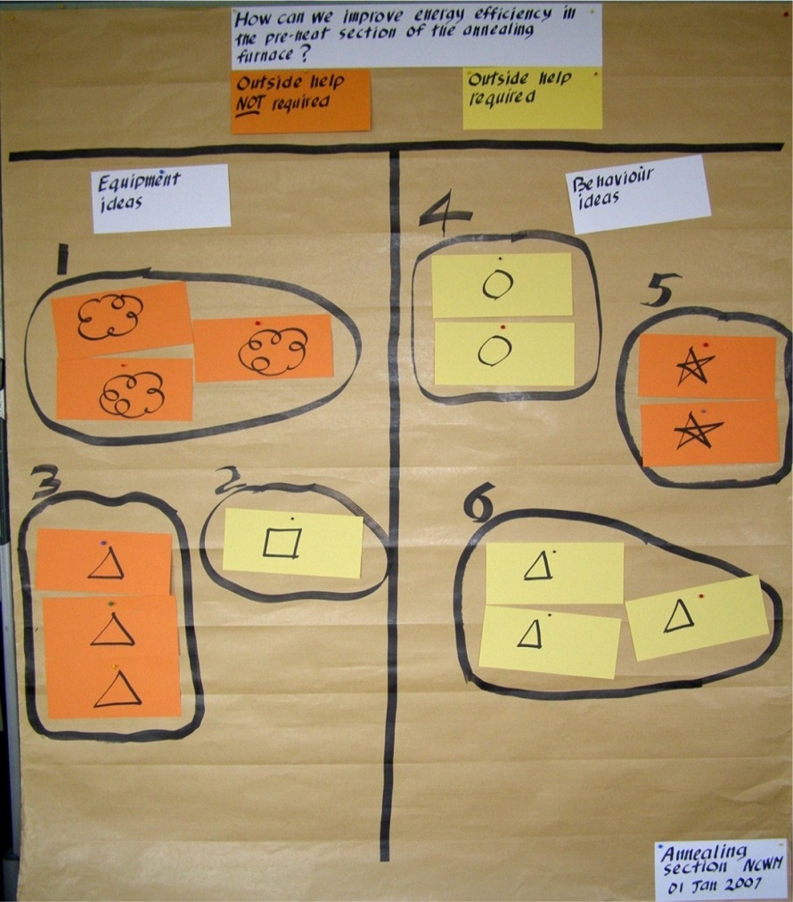
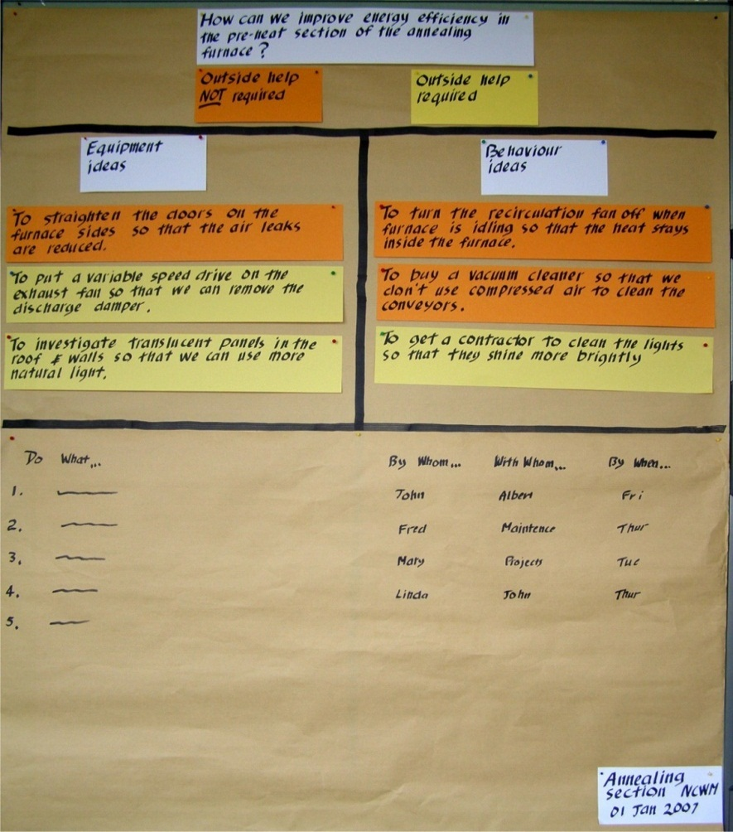
Document the session with photos
Photograph each chart so that you have an honest record of the discussion and support those who have committed to take action.
Creating and Grouping ideas …
Concretising and Deciding ideas …

Slide 13
So remember when running the session to…
Set up a space with charts, cards, pins, glue or blue tac etc as per the templates provided in the preceding slides
Explain purpose of the session and show overall process slides
Put up the focus question on the chart and get ideas using the 2 categories – “behaviour/operational” & “equipment/controls” … ask them to write the ideas down on cards so that you can pin them up
Get group to sort ideas into like groups
Consolidate ideas by asking them in small groups or pairs to write a “We should… so that…. “ statement for each group of “similar” ideas
Finally….get them to write down what first activity they will undertake to get the ball rolling on these ideas
Oh and one last thing –use colour coding for ideas, it makes it easier for people to follow the structure!

Slide 14
Make sure you follow up!
Now you have actions committed to, you should follow through so that those participating remain motivated to participate again
Identify who the ideas should be referred to especially those ideas that require external assistance at the site
Write down what you will do to follow up with this person before the session is over under the next activities section in Step 3
Communicate to the group before and after the brainstorm session what will happen to their ideas
Remember …IF you don’t do the feedback yourself, then arrange for someone else to do it

Slide 15
Checklist for preparing the session
Have I invited everyone who should be there?
  best in writing
  include free lunch and follow up with a call or face to face
Have I scheduled a motivating time of the day?
  best just before lunch so the group can discuss ideas over a feed
Have I prepared the 2 Charts as per Steps 1, 2 and 3?
Do I have a case example or question about resource efficiency so they can practice writing ideas down or thinking about ideas in their area?
  Example: “Where in our work area do we use energy and emit Greenhouse gases?”
Do I have enough materials ?
  Marker pens: 1 each.
  Orange cards for equipment ideas: say 20
  Yellow cards for behavior ideas: say 20
  Orange stripes for equipment purpose statements: say 20
  Yellow stripes for behaviour purpose statements: say 20
  “we should….. so that….” (concretized ideas)

Slide 16
Checklist for conducting the session
Have I greeted everybody and thanked them for coming along?
Have I got everyone‘s agreement on the purpose and importance of this session?
  ie: “To generate ideas we have about energy and water use in ‘a specific work area’ so that later ideas can be turned into real opportunities for savings by ourselves or others”
Am I ready to follow the structure?
  Get them to practice using warm-up question or case example
  Get ideas using focusing question
  Sort ideas
  Get them to concretize ideas in pairs
  List down what they will do (next activities) to progress these ideas
Am I prepared to ask the group to help with packing up the materials and disposing of waste in an appropriate way?

Slide 17
Checklist for follow-up
Do I have access to digital camera or smartphone so that I can take photos and distribute photos of charts and the group to evidence the collaborative effort on resource efficiency and carbon reduction at the site?
Do I have the names of contacts for referring our ideas to the appropriate site personnel?
Do I know how to follow up on ideas so that those who have contributed get the motivating feedback that is critical to the success of this type of initiative?
Have I made a note in my diary to follow up on all of these activities?

Slide 18
Next steps
Quantify savings using calculators in opportunities workbook
then reconvene in a week or so to prioritise opportunities
See next slide for prioritising opportunities

Slide 19
Prioritising opportunities second workshop option
Present energy targets , baseline, high level plans
Present related policies and business plans
Indentify the criteria to prioritise the best or most immediate opportunities eg less than 3 year payback, contributes to the profitability of our new afternoon shifts, supports green credentials etc
Facilitate agreement on where each opportunity fits on the following matrix

Slide 20
&/OR: Step 2 – project priorities - given our agreed criteria for EE projects which top 5 quantified opportunities should we progress for this quarter or year ?

Slide 21
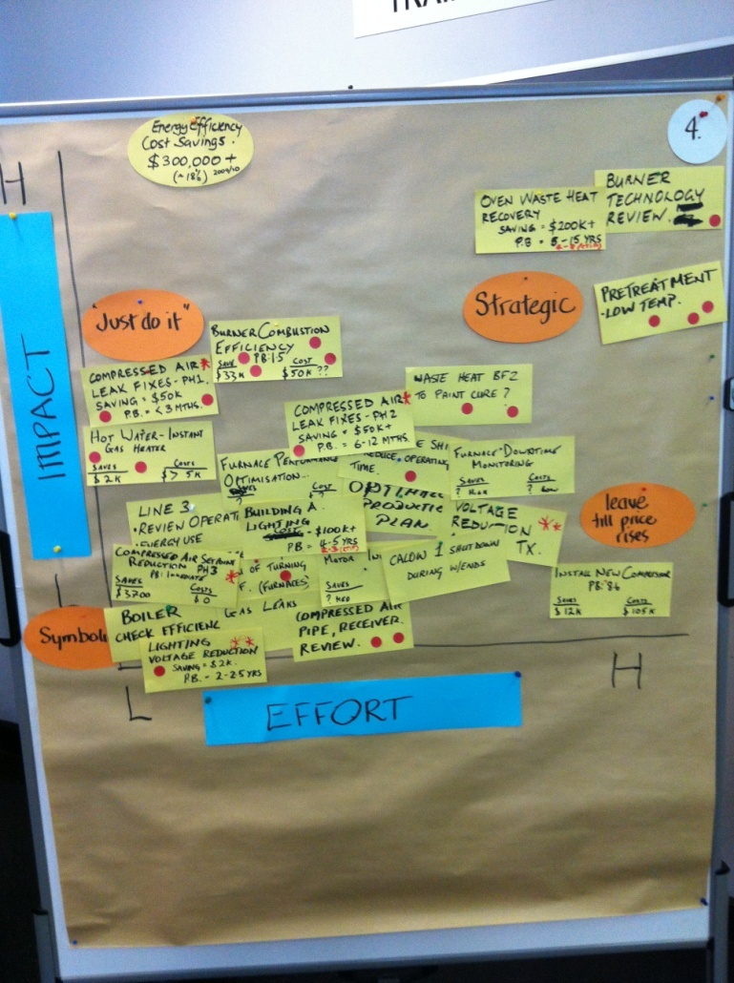
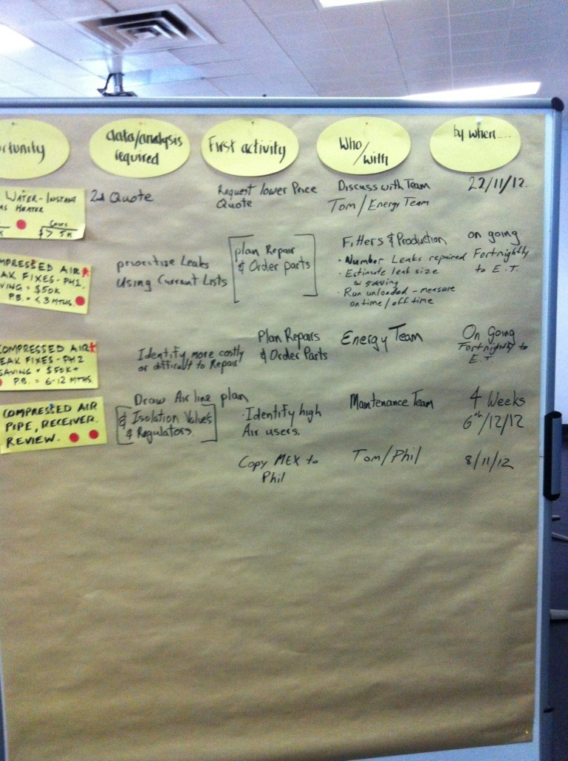
Engage the team in prioritising and action planning
Prioritize ideas …
Action plan …

Slide 22
Action planning template
Opportunity | First activity | Who with | By when | Budget year
Air Receiver | Get quote for additional air receiver | Phillip Kruger | 2/6/13 | 2013
Oven calibration | Get quote on annealing oven calibration | Mark Bridger | 8/7/13 | 2013
High bay lighting | Get quote and info on highbay lighting upgrade | Clive Willis | 9/9/13 | 2014

