Slide 1


Insert site / company name and logo here
Embedding Energy Management
– Energy management systems presentation
Embedding Energy Management is available from www.sustainabilityskills.net.au
Manufacturing Skills Australia
1800 358 458
info@mskills.com.au
www.mskills.com.au
© 2013 Manufacturing Skills Australia. All rights reserved
Insert presenter/s names here
The material provided in this presentation has been produced in conjunction with our partner Energetics Pty Ltd.
This publication was funded by the Australian Government
through the Workforce Innovation Program under the title 'Carbonproof for Foundries'.
Notes:
1

Slide 2
What is a systems approach to energy management?
  A systems approach to energy management is an approach, which involves an integrated and consistent application of a set of key processes to ensure sustained energy savings.
  A systematic approach to energy management focuses on improving energy performance by integrating energy into existing processes e.g. maintenance contracts or establishing new processes e.g. creating a new energy improvement team.

Slide 3
Through the systems approach an organisation can:
  Sustain waste reduction
  Improve operations
  Heighten awareness and change energy use practices
  Integrate energy management into design
  Innovate on energy sources with corresponding greenhouse improvements

Slide 4
Building Blocks of Sustainable
Energy Management
ACHIEVEMENT
PLANT &
EQUIPMENT
MEASURING,
REPORTING &
FEEDBACK
FINANCIAL
MANAGEMENT
SUPPLY
MANAGEMENT
OPERATIONS &
MAINTENANCE
LEADERSHIP
UNDERSTANDING/
BENCHMARKING
PLANNING
PEOPLE
Source: Energetics Pty Ltd 2012

Slide 5
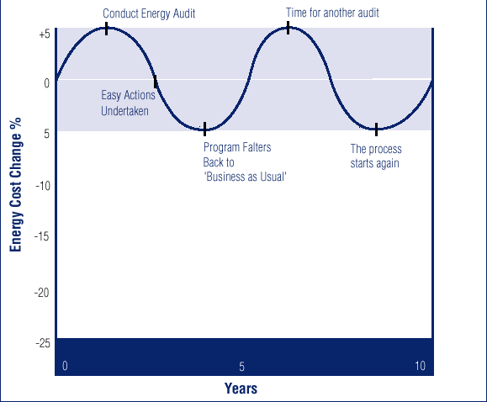
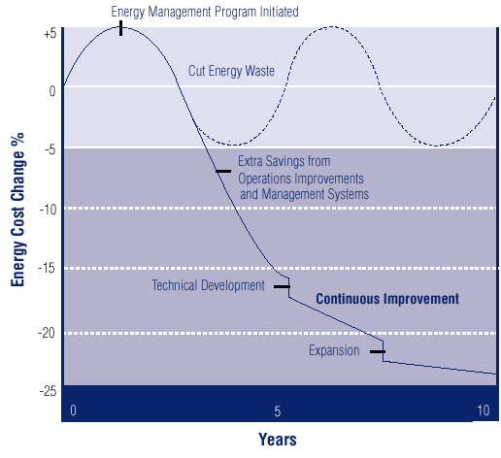
Tackling Energy Management
Traditional Approach
“VS”
Systems Approach
Tactical, Project Basis
No context of ongoing reporting
No Long-term Sustainability
Authority to act unclear
Strategic, Program Basis
Integrated to Business / Processes
Continuous Improvement Functions
Balanced Organizational Structure, Process, People, and Systems

Slide 6
Traditional Approach
Management says costs are too
high again: Where’s that last audit?
Costs are high,
let’s do an Audit
Easy Savings Here!
This feels
familiar!
Costs
+5%
0
-5%
Oh well that’s enough,
Manager says get on
with other programs.
-10%
-15%
-20%
-25%
0
5
10
Source: Energetics Pty Ltd
Years

Slide 7
Senior management want to help us reduce costs
Systems Approach
Easy Savings
are just the start
Costs
+5%
The operations and maintenance
guys are finding more savings.
They have put in systems to lock them in.
0
-5%
That new process modeling system is saving energy and boosting production!
-10%
That new plant is
really energy efficient.
-15%
-20%
-25%
Technical
Development
Expansion
0
5
10
Source: Energetics Pty Ltd
Years

Slide 8
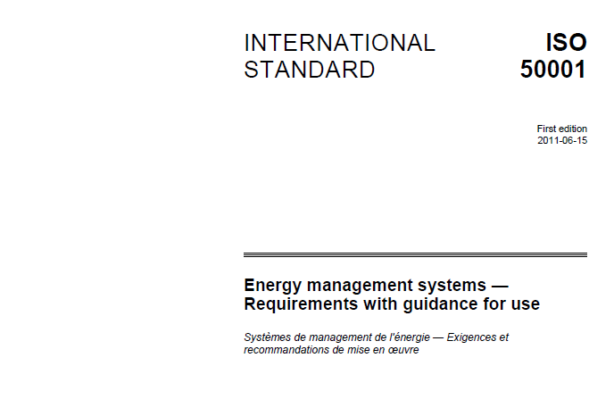
Energy management underpinned by standards
Energy Efficiency Opportunities (EEO) framework
DRET 2005

Slide 9
Establishing or improving energy management systems
Present energy targets/goals/KPIs policies
Diagnose current systems capacity to deliver & sustain savings
Develop a list of critical actions and project briefs
Monitor implementation using regular CI and management meetings
Re diagnose and benchmark system
- diagnose, benchmark and improve elements of an EMS so that energy savings are accelerated and sustained over a longer timeframe – e.g. leadership, monitoring & reporting, operations & maintenance , finance and budgets, training and awareness

Slide 10
Typical Improvement Steps at Foundries
Establish formal energy/GHG savings targets, and Star Rating target.
Write an energy policy with specific energy intensity targets using KPI/s, and make energy management a regular item at business review meetings. Discuss and ensure targets are understood and accepted by operations.
Review accountabilities to ensure clear and documented assignment to operations.
Implement improved reporting and feedback systems so operators can effectively identify and act on variances from target performance.

Slide 11
Typical KPIs at Foundries
Energy per tonne (t) kWh/t in good castings
Energy per tonne melted kWh/t
Ratio energy good castings: melted
Electricity per tonne in kWh/t good castings
Electricity per tonne melted kWh/t
Ratio electricity good castings: melted
Furnace electrical consumption kWh/t melted
Furnace natural gas consumption kWh/t melted
Overall yield %
Tonnes melted or tonnes shipped per employee t/fte-mth
Ratio melting energy kWh/t to theoretical energy kWh/t

Slide 12
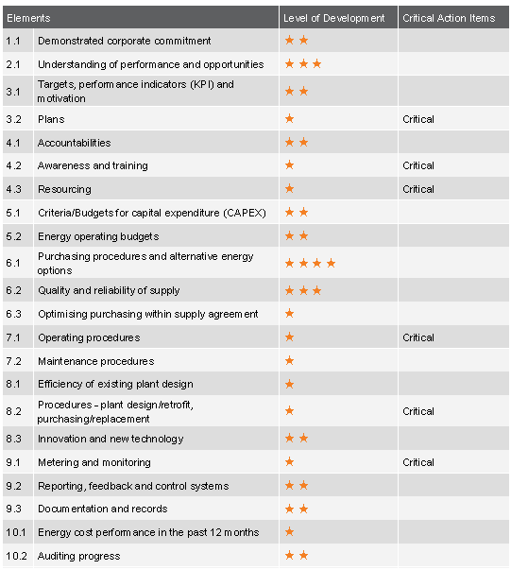
Diagnostic Results – Element Analysis

Slide 13
Energy management systems Diagnostic tools
Energy Management Systems ISO50000 audit
BRESCU matrix
One2Five energy
NSW government energy saver energy management checklist

